Slide 1
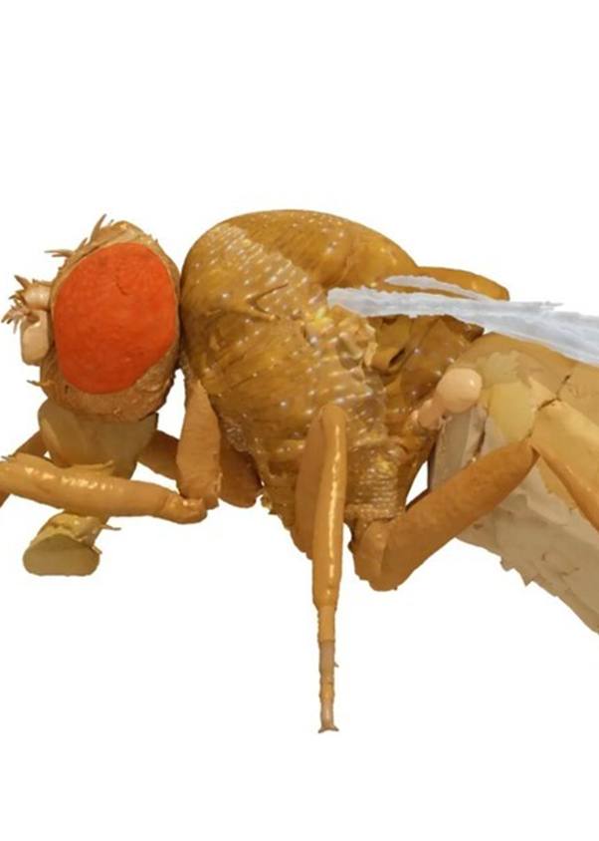
Enabling Spatial Awareness through the Implementation
of Bio-Inspired Path Integration Mechanisms
NeuroMechFly 2.0 Navigation
Jean Cordonnier
Flore Munier-Jolain
semester project
professor: Prof. Ramdya
supervisor: Victor Alfred Stimpfling
12/01/2024

Slide 2
Contents
Introduction
State-of-the-art
Random Walk
Turning behavior
Heading change regression
Follow a heading: PID controller
Reinforcement learning
Final simulation
Critics
Next steps

Slide 3
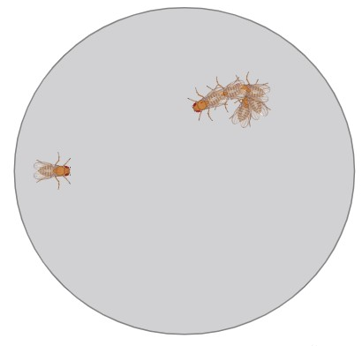
Introduction
Maintain spatial awareness
Remember the location of a food site
Go back to its starting point
1 Random Walk
▶ Efficient walk
▶ Stop criteria
[Behbahani et al, 2021]
2 Integration of return heading
▶ Precise return vector
▶ Biologically relevant
▶ RL friendly
3 Heading follow
▶ Turning challenge
▶ Smooth follow
▶ Stop criteria

Slide 4
State-of-the-art
Insects have a remarkable aptitude for navigation, relying on various cues:
visual cues (sunlight, visual landmarks …) ^{[1]}
mechanosensation (odor, wind, sound perceptions) ^{[1]}
proprioceptive information ^{[2]}
Neural dynamic compass-like representation of the fly’s orientation ^{[3]}
Integrate all these biological mechanisms to our virtual controller

Slide 5
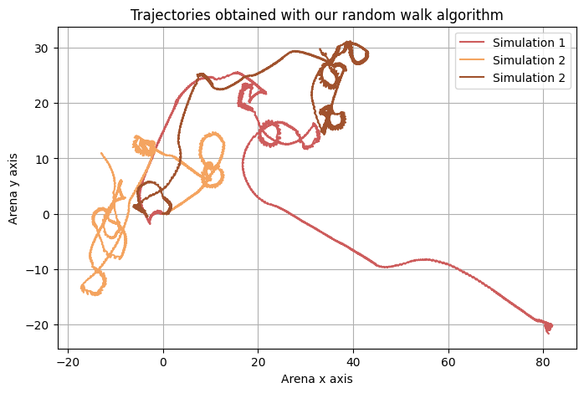
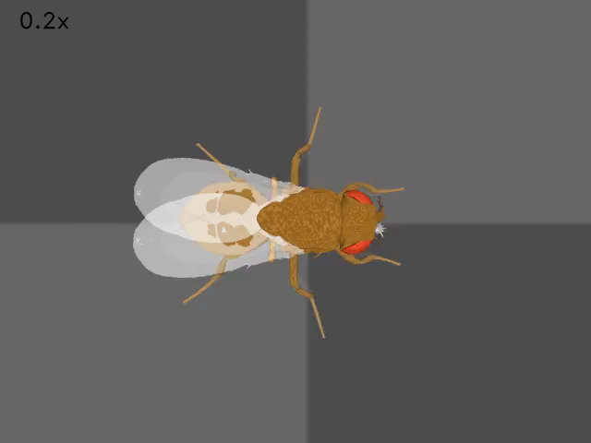
Results: Random walk
Simulation 2
Complex random trajectories

Slide 6
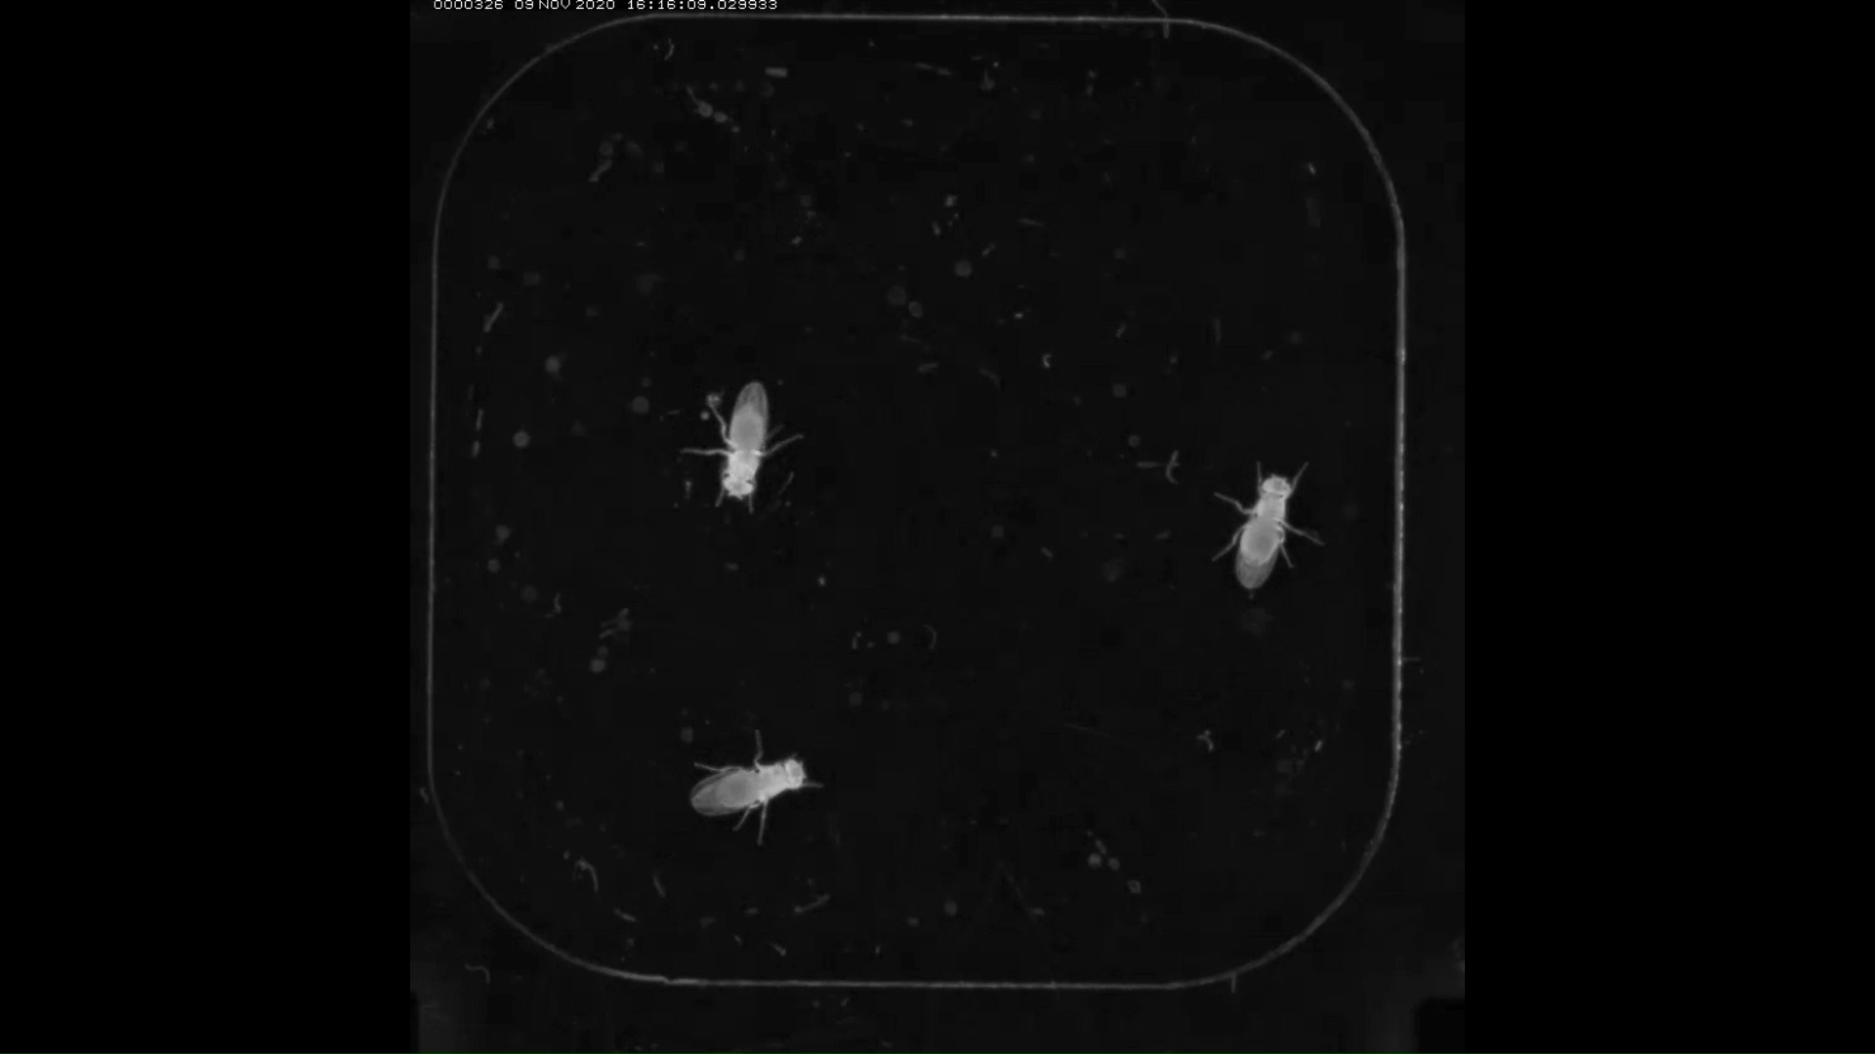
Turning displacements
Natural fly displacements contains tight turns
At the end of the Random Walk the fly has to turn around
Coordinated tripod pattern

Slide 7
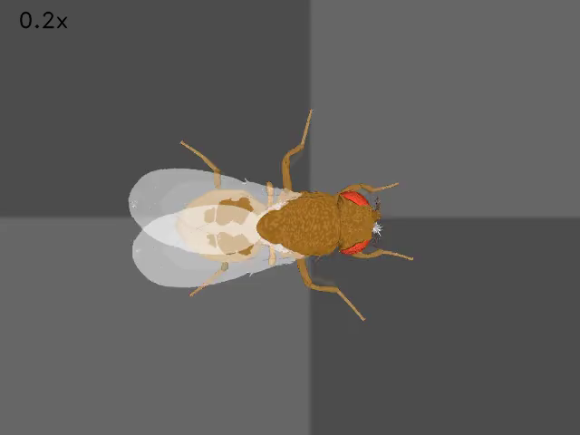
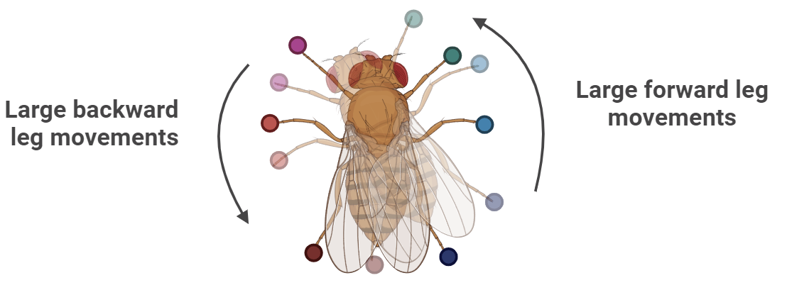
Turning implementation
Coordinated tripod pattern modeled using a CPG controller
Negative - Positive signs: opposite CPG frequencies between Right and Left
Large amplitudes: large amplitude movements increase turning efficacy
[δ_{L} , δ_{R}] = [+-1.2 , -+1.2]

Slide 8
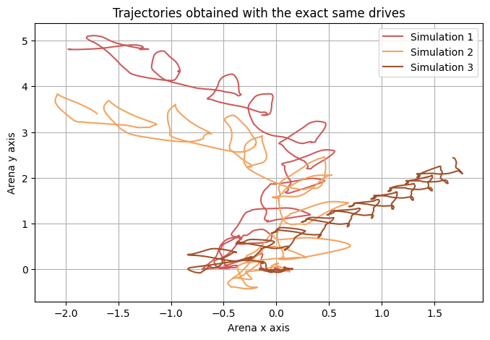
Turning problems
Different trajectories using the same coefficients
[δ_{L} ,δ_{R}] = [-1.2, 1.2] for 10’000 steps
No CPG reset between simulations
Non robust implementation

Slide 9

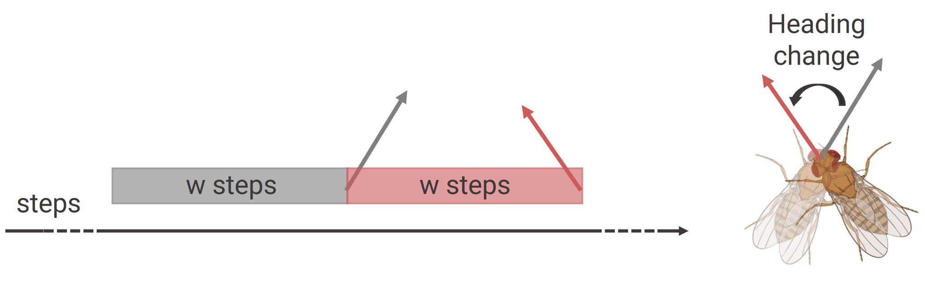
Heading change regression
Descending drives input [δ_{L} ,δ_{R}]
Proprioceptive leg positions
Biologically relevant
Random trajectories database with all range of movements and simulation features for each step
Mean velocity vectors used as heading vector
Sliding window principle (w=4000)

Slide 10
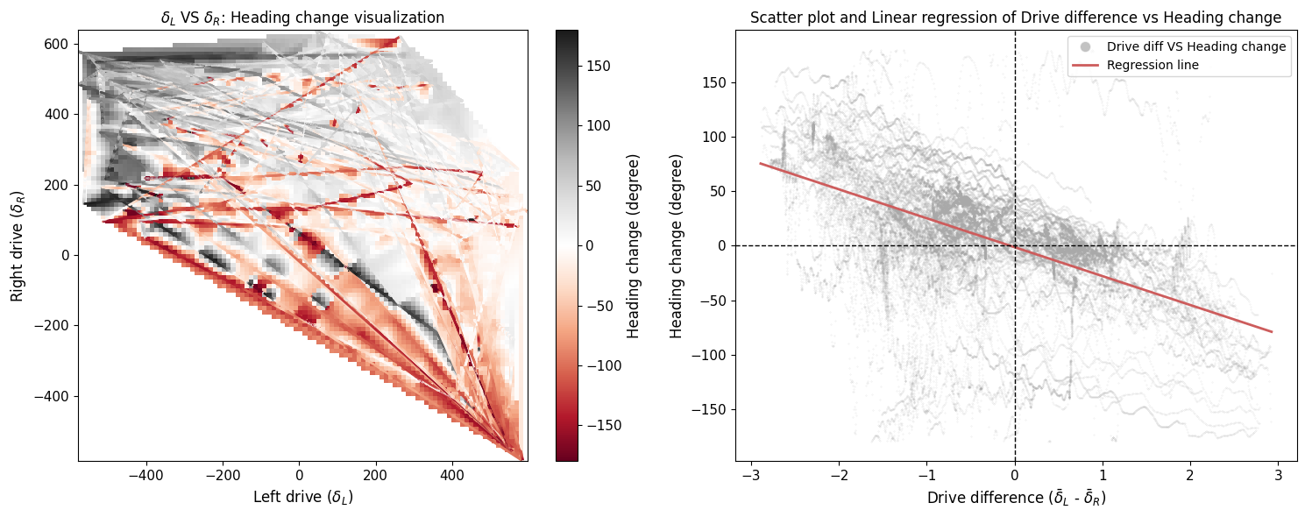
Regression using descending drives
Distinct correlation pattern associating descending drives and heading changes
Many “outlier” heading changes

Slide 11
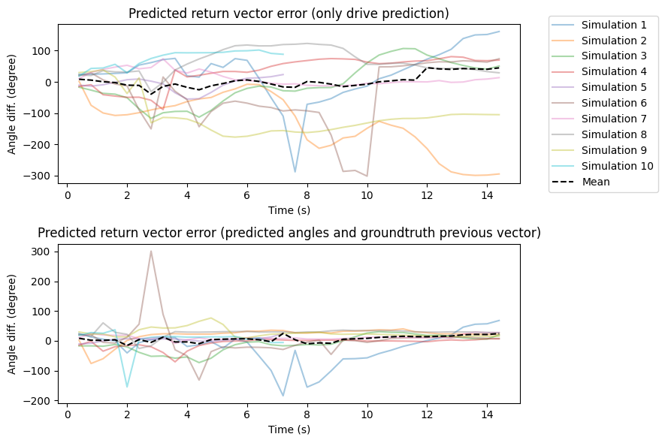
Results: descending drives regression
Inaccurate return heading vectors
Use ground truth previous vector for prediction
Better return heading vectors

Slide 12
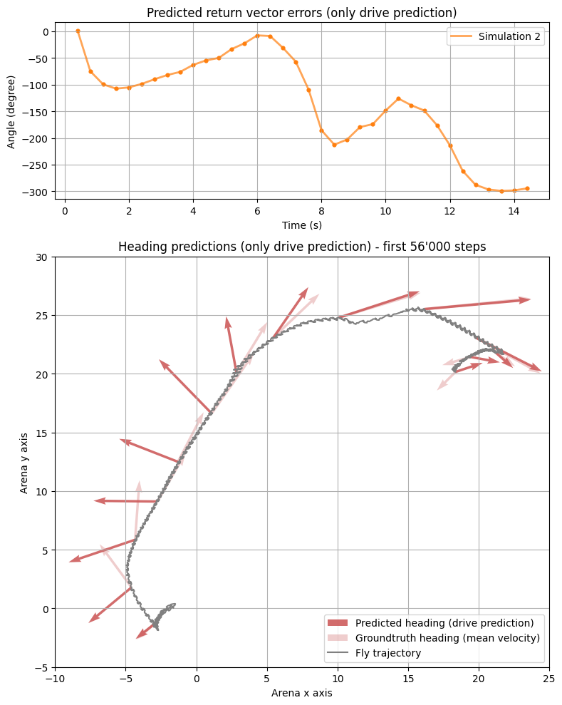
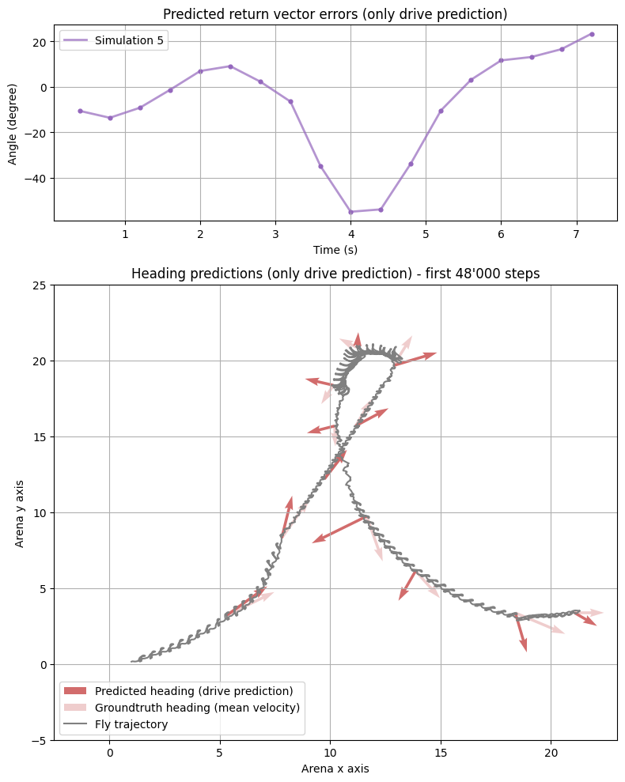
Results: using only drive predictions
Error propagation

Slide 13
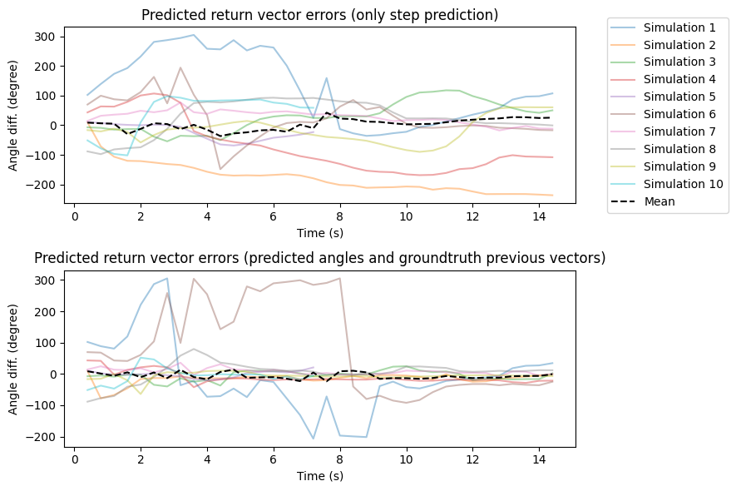
Results: “proprioceptive” regression
Inaccurate return heading vectors
Use ground truth previous vector for prediction
Better return heading vectors

Slide 14
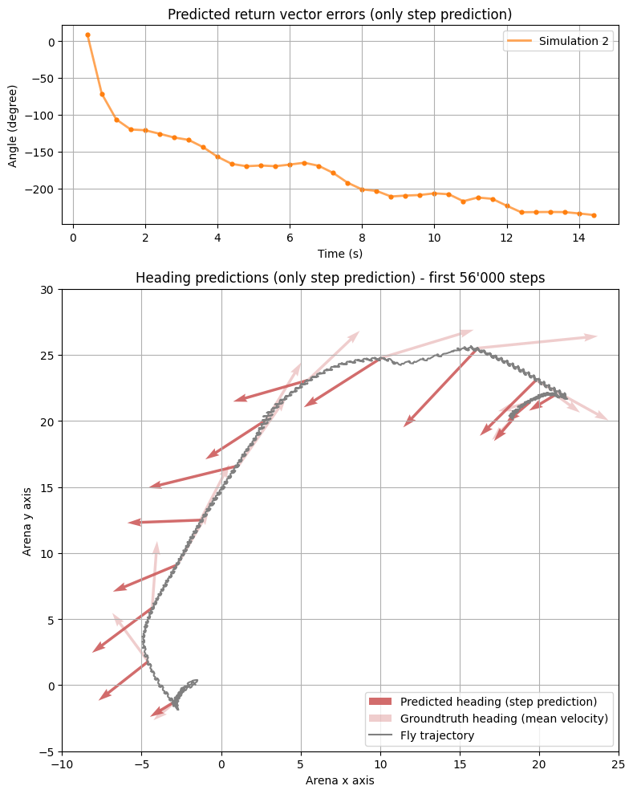
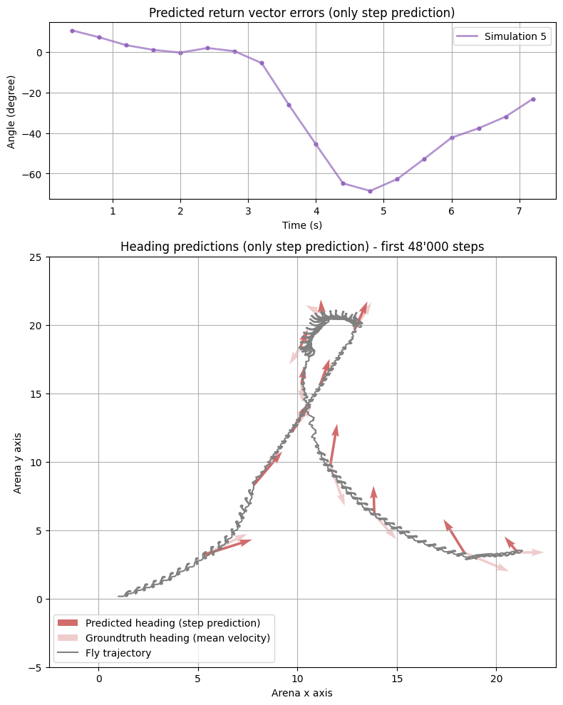
Results: using only drive predictions
Error propagation

Slide 15
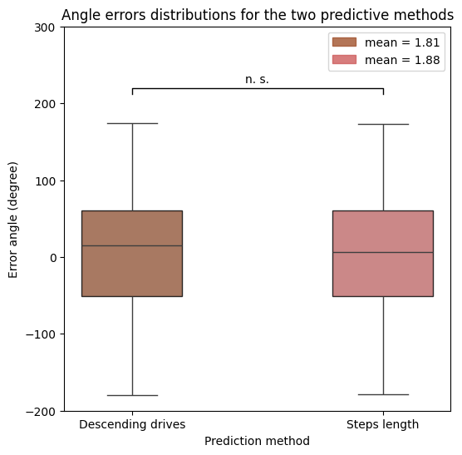
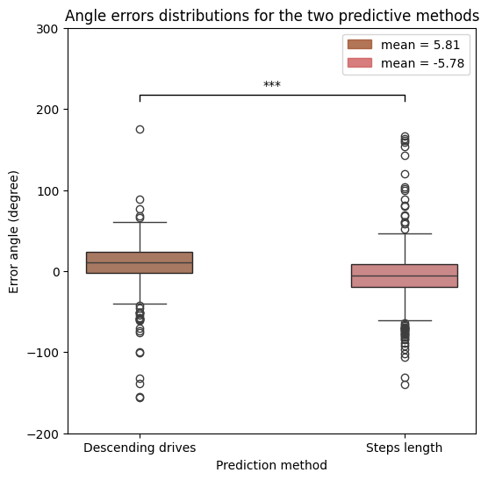
Regression models conclusion
Only drive predictions
Groundtruth previous vector
Both models inaccurately predict heading changes associated with sharp turns
“Proprioceptive” regression model seems to predict more precise heading changes angles

Slide 16
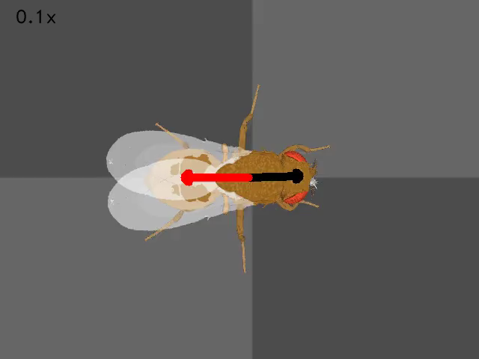
Heading following: PID controller
Goal: make the fly follow a selected heading using a PID controller
Very hard to tune with stability problems but works well for small heading change
We computed the error from a goal heading and put it into a simple PID controller

Slide 17
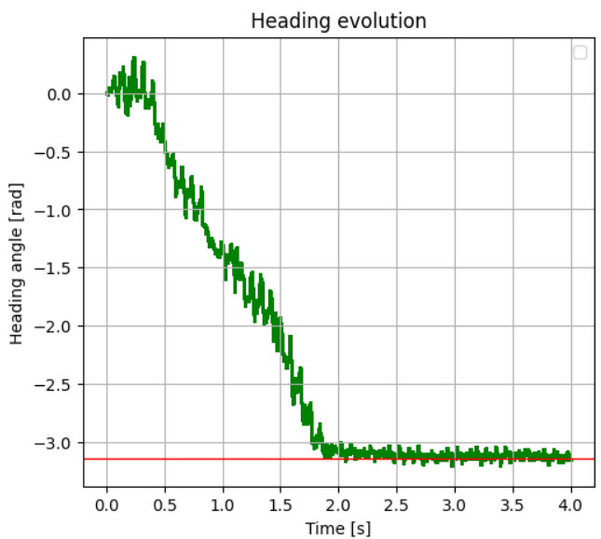
Heading following
Heading following: PID controller
PID controller: results
No overshoot
The fly manages to reach the heading objective smoothly
Slow start
%% ADD graphs of heading

Slide 18
Reinforcement learning
To explore new ways of determining the heading: with idiothetic or allothetic cues → LSTM
To explore new ways of controlling the fly → Hybrid CPG-RL controller optimized for turning
To make the fly make optimal decision based on her environment
We think that using a RL-based approach to solve this problem would be efficient due to the high dimensionality and high degree of complexity of the simulation

Slide 19
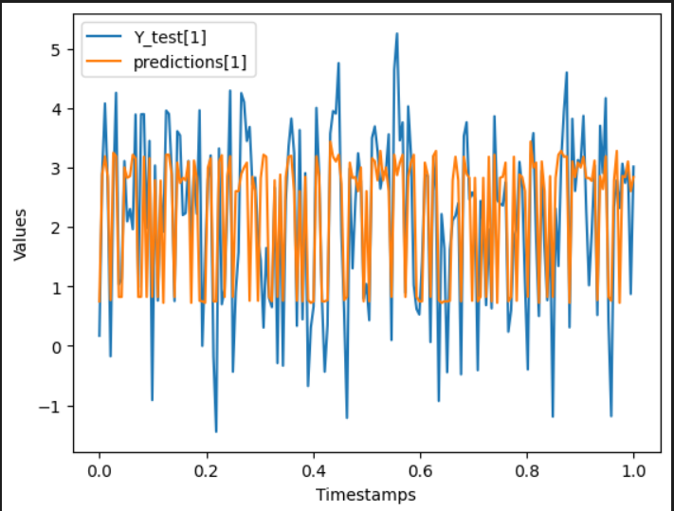
Reinforcement learning: LSTM
Evaluation on the test set
Final mse loss : 1.0438
Trained on 1746 samples of 3000 steps simulation
Inputs: Descending drive
Output: position in fly body frame
One separate network for X and Y position
The network fails to cover maximas and minimas correctly but manages to get approximation on the difference in position after 3000 steps

Slide 20
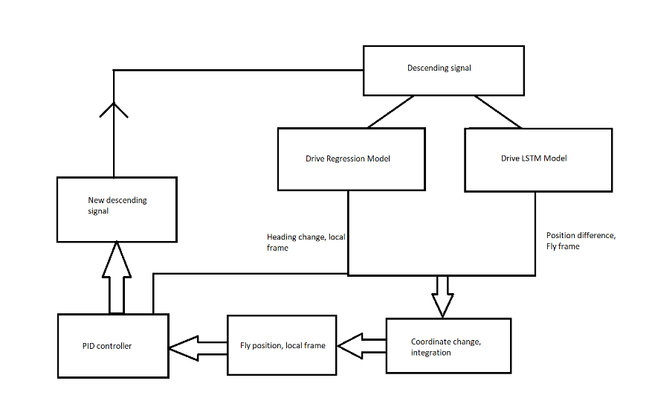
Final simulation

Slide 21
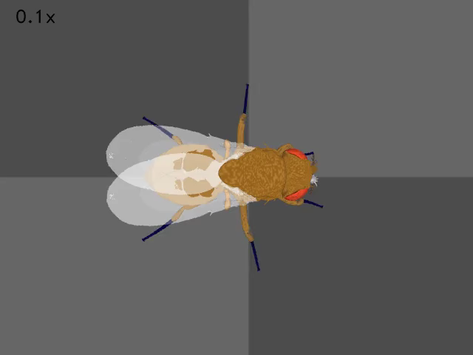
Final simulation

Slide 22
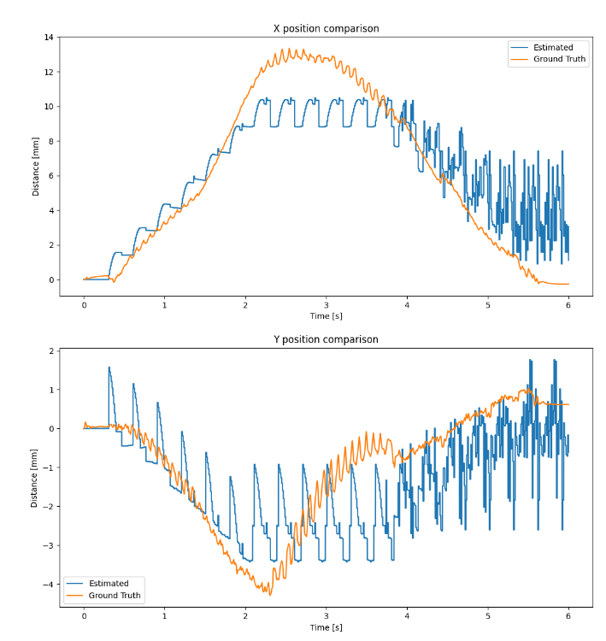
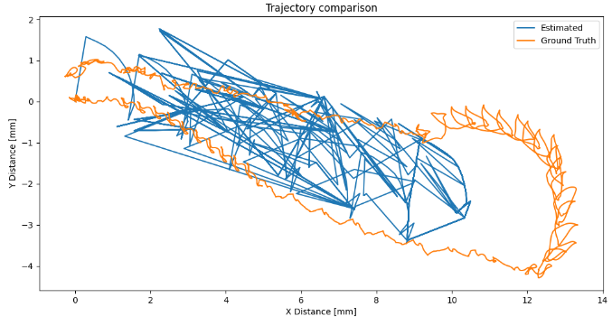
Final simulation
X and Y estimations seems to fit
Drift is reasonable
A lot of noise on Y coordinates
Combined estimation are still erratic

Slide 23
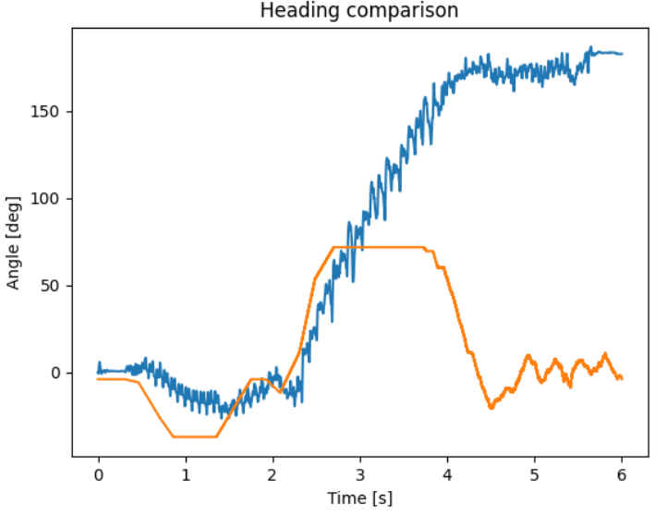
Final simulation
Our model is restricted for high differential drive over a long period of time
We used the estimation at first before realising we could not use it to estimate a full turn
The linear regression model was not able to predict heading change that important over such a short period of time

Slide 24
Critics
We still have a non natural, jerky turning behavior → model limitations
We did not try to apply our regression model to smoother trajectories
Incapacity of using the linear regression on the final simulation
The trained models did not apply well to the controller as it was not trained for it

Slide 25
Next steps
Random walk with smoother transition between descending drive combinations
More robust trajectory controller
Arbitrary return distance → concrete targets (food …)
Use the position to predict the descending drive
And the ambitious ultimate step …
Create a biologically relevant Neural network for this task

Slide 26
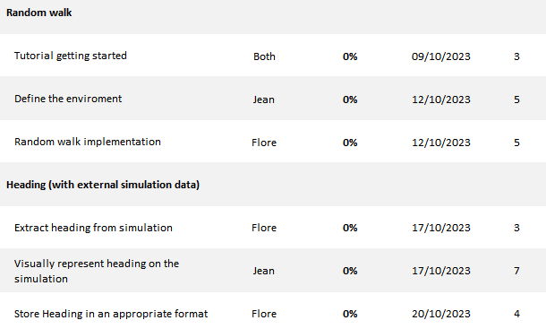

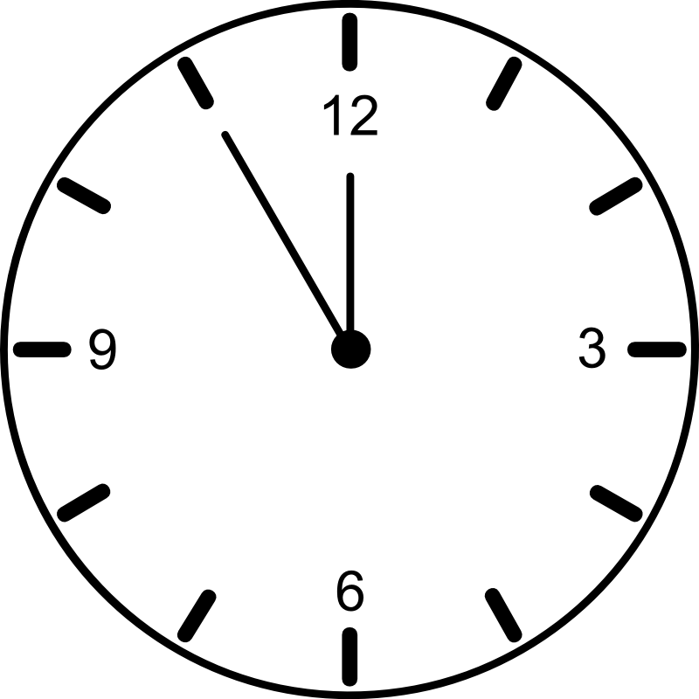
Original Gannt chart
days

Slide 27
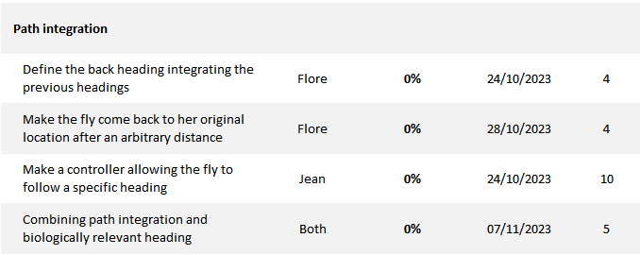
Original Gannt chart
days
Spent a lot of time designing predictive models based on linear regressions

Slide 28

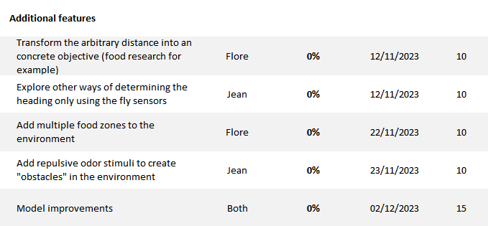
Original Gannt chart

Slide 29
Original Gannt chart
We spent time comparing “orientation” and “velocity” vectors extracted from the simulation
Trying to implement a efficient turning behavior was quite a time consuming challenge in our project
Duplicated efforts for the design of predictive model pipeline

Slide 30
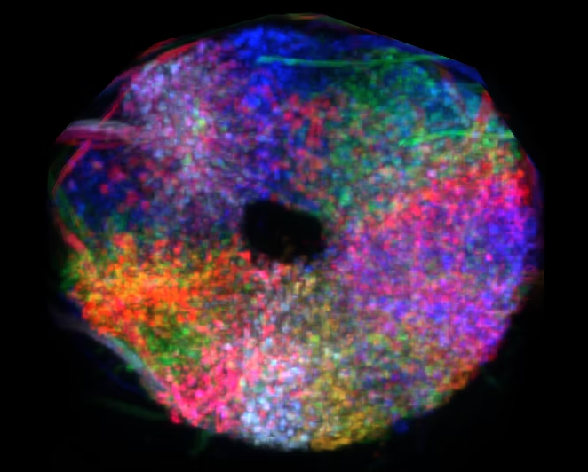
Thanks for your attention
?

Slide 31
References
[1] Currier and Katherine Nagel. Multisensory control of navigation in the fruit fly. Current opinion in neurobiology, 12 2019.
[2] John C. Tuthill and Eiman Azim. Proprioception. Current Biology Magazine, 04 2018.
[3] Johannes D. Seelig and Vivek Jayaraman. Neural dynamics for landmark orientation and angular path integration. Nature, 05 2015.

